Slide 1
Data Structure & Algorithm: Music player
Course project!
Our Music Playlists
Search
Home
Library
Nguyen Hong Son – ITDSIU21117

Slide 2
Contents of this template
Ovewview | Introduction about the project
User Interface | What is it look likes? How to use the application ?
Hashtable | Why hashtable ? How it work ?
Doubly Linked List | What’s the purpose ? Functions ?
Design Pattern | Singleton pattern
Conclusion | Summarize whole the project

Slide 3
01
Overview
Our Music Playlists
Search
Home
Library
Introduction about the product

Slide 4


Introduction
The Music Player App is a desktop application developed using Python and the Tkinter library.
It allows users to play, pause, and navigate through their music library, as well as create and manage playlists.
The app features a user-friendly interface with search functionality, allowing users to easily find and add songs to their playlists.

Slide 5
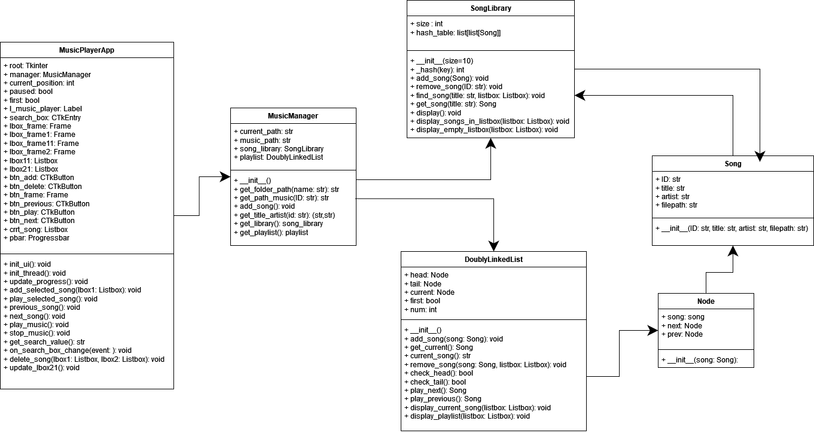
UML Diagram

Slide 6

Friendly User Interface
-Part 02-

Slide 7
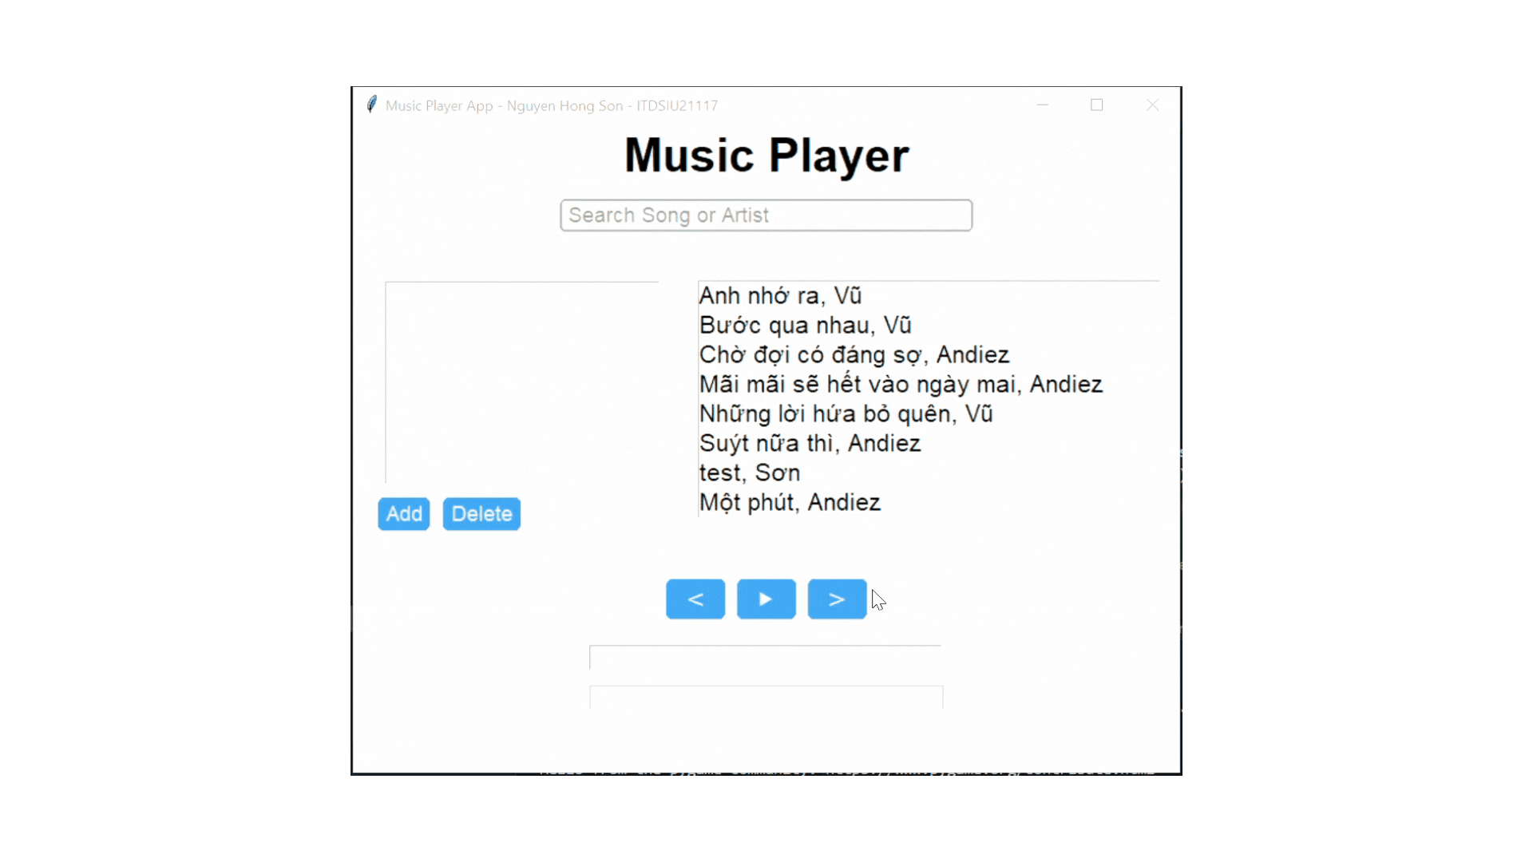
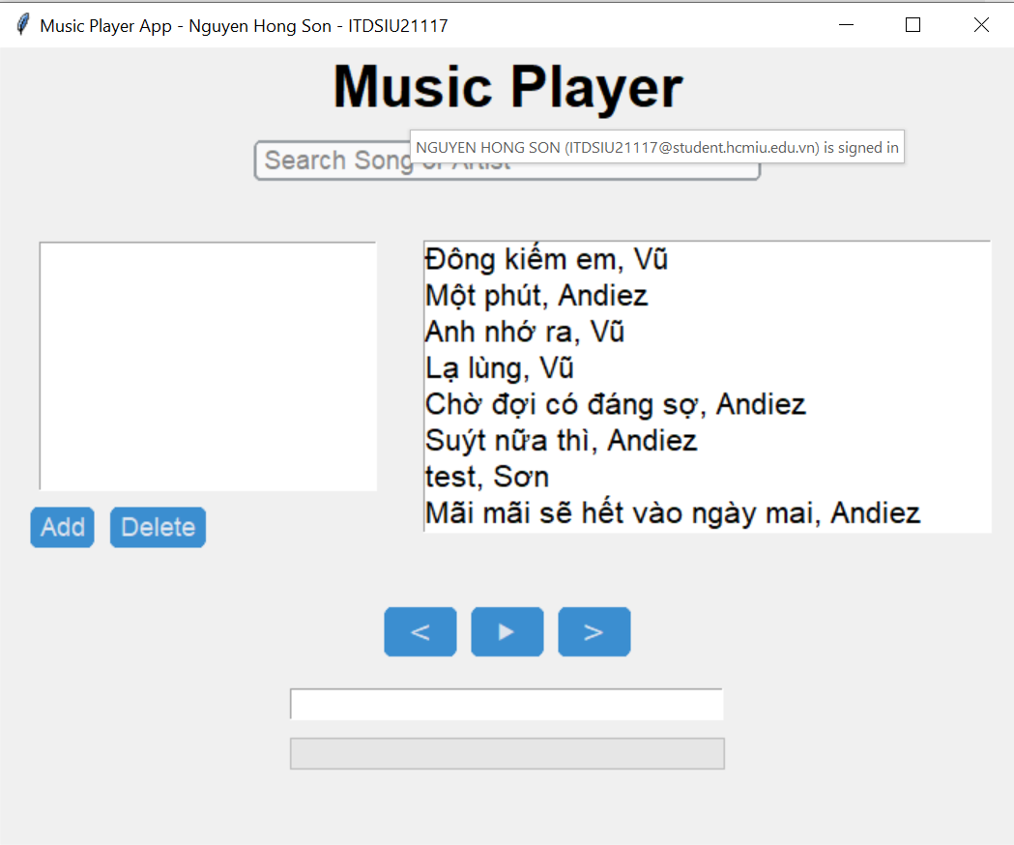

Main screen
Add song into playlist
Play or pause current song
Next song
Previous song
Current song ‘s title
Process bar
Search song’s title or artist

Slide 8
Data Structure & Algorithm
03
Our Music Playlists
Search
Home
Library

Slide 9
Hash table
Our Music Library
Search
Home
Library

Slide 10
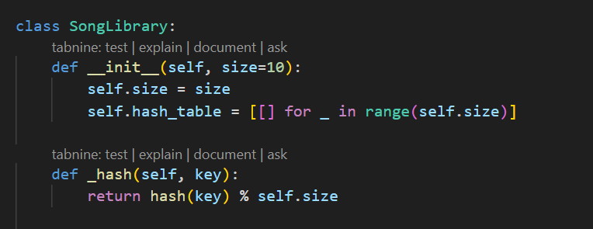
Hash table
Using for song library.
Hash tables provide constant-time complexity for search, insert, and delete operations.
SongLibrary class is a simple implementation of a hash table using separate chaining to handle collisions.

Slide 11
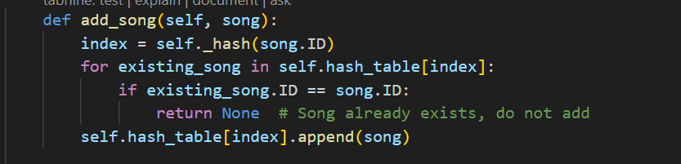
Hash table – insert method
O(n)
O(1)
The add_song method in the SongLibrary class is responsible for adding a new song to the hash table.
Average case: O(1) + O(1) + O(1) + O(1) = O(1)
In the average case, where collisions are well-distributed, the method runs in constant time.
Worst case: O(1) + O(n) + O(1) + O(1) = O(n)
In the worst case, where all songs hash to the same index, the method’s time complexity is linear with respect to the number of songs at that index.

Slide 12
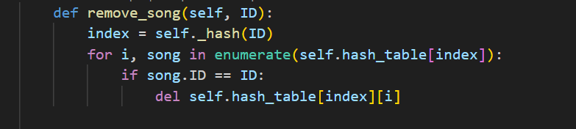
Hash table – delete method
O(n)
O(1)
The remove_song method in the SongLibrary class is responsible for removing a song from the hash table, given its ID.
Average case: O(1) + O(1) + O(1) = O(1)
In the average case, where collisions are well-distributed and the song to be removed is near the end of the list, the method runs in constant time.
Worst case: O(1) + O(n) + O(n) = O(n)
In the worst case, where all songs hash to the same index and the song to be removed is at the beginning of the list, the method's time complexity is linear with respect to the number of songs at that index.

Slide 13
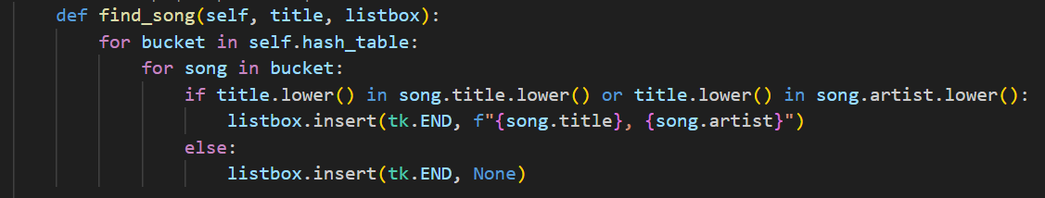
Hash table – search method
The find_song method in the SongLibrary class is responsible for finding songs that match a given title (or artist) and displaying the results in a listbox.
Average case: O(m) + O(1) + O(k) + O(1) = O(m + k)
In the average case, the method's time complexity is linear with respect to the size of the hash table and the length of the search term.
Worst case: O(m) + O(n) + O(k) + O(1) = O(m * n + k)
In the worst case, where all songs hash to the same index, the method's time complexity is linear with respect to the size of the hash table, the number of songs at each index, and the length of the search term.

Slide 14
Doubly Linked List
Our Music Library
Search
Home
Library

Slide 15
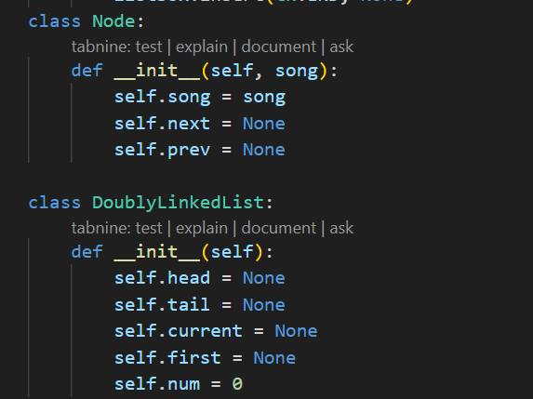
Doubly linked list
Using for song playlist.
Easily traverse the playlist in both forward and backward directions.
In a doubly linked list, adding or removing elements from the beginning or end of the list takes constant time (O(1)).

Slide 16
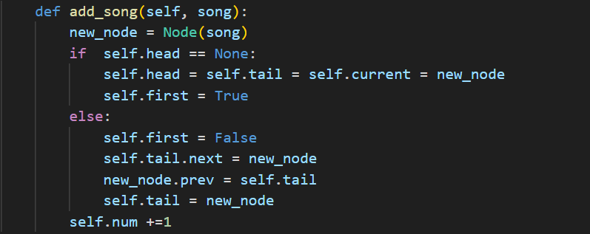
Doubly linked list – insert method
The add_song method in the DoublyLinkedList class is responsible for adding a new song to the linked list data structure that stores the songs.
The overall time complexity of the add_song method is O(1), as it involves a constant number of operations, regardless of the size of the linked list.

Slide 17
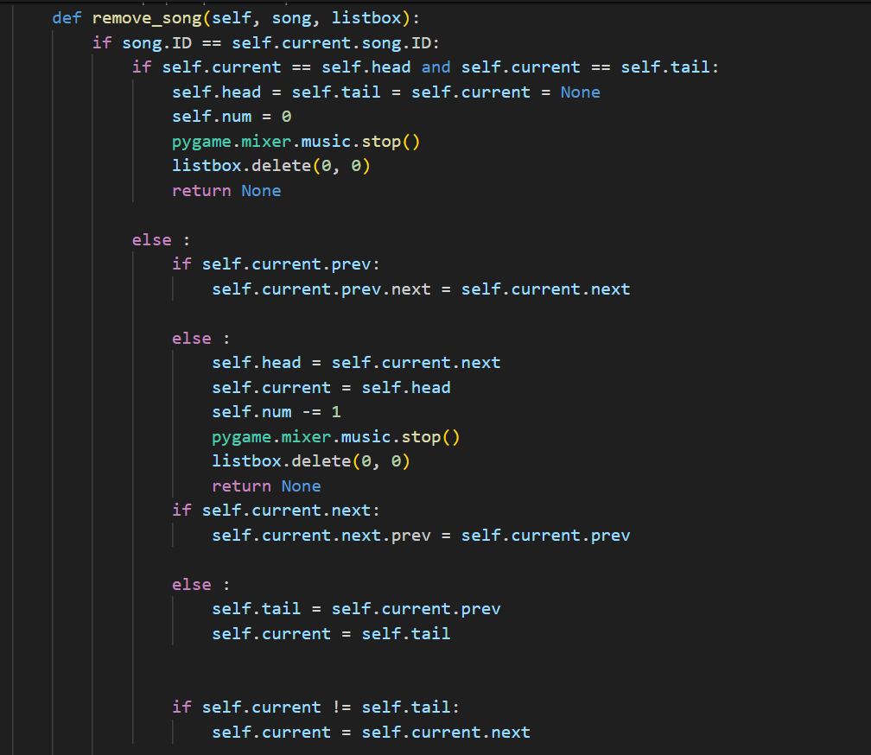
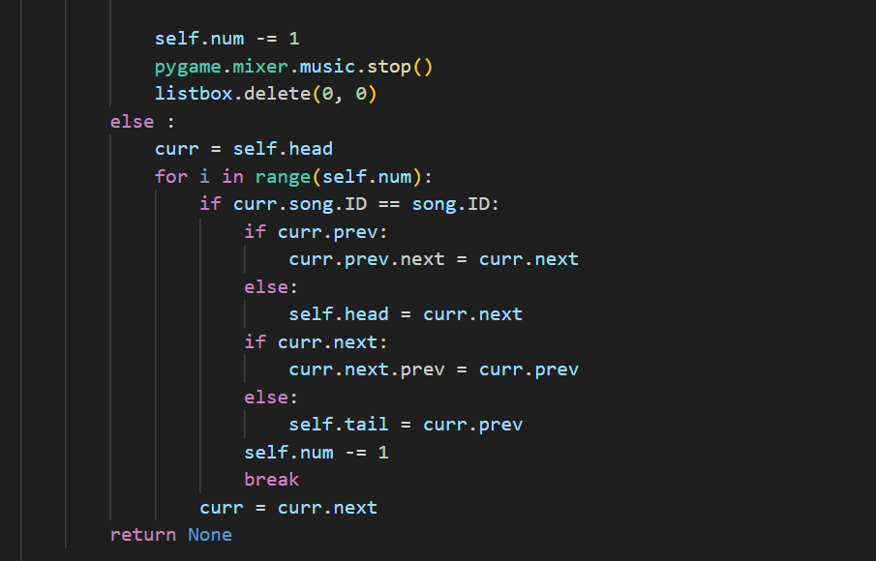
Doubly linked list – remove method

Slide 18
Doubly linked list – remove method
The remove_song method in the DoublyLinkedList class is responsible for removing a specific song from the library or the playlist.
The method efficiently handles the case where the current song is being removed, with a time complexity of O(1) for that scenario. However, the linear search through the doubly-linked list for non-current songs contributes to theoverall O(n) time complexity of the method.

Slide 19
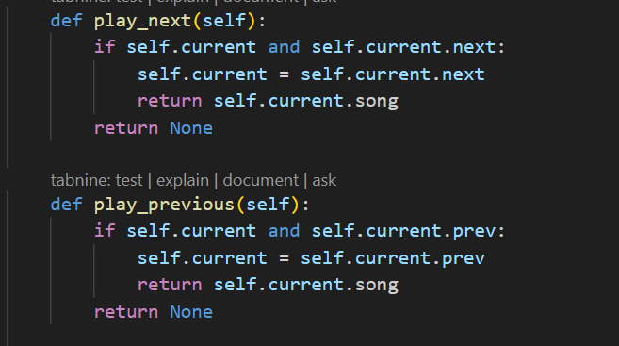
Play next and previous method
The play_next and play_previous methods in the DoublyLinkedList class are responsible for moving the self.current pointer to the next or previous song in the playlist, and returning the corresponding song object.
The overall time complexity of both the play_next and play_previous methods is O(1), as they involve a constant number of operations. This is because the methods perform a constant number of pointer updates and do not need to traverse the entire list.

Slide 20
04
Design Pattern
Our Music Playlists
Search
Home
Library

Slide 21
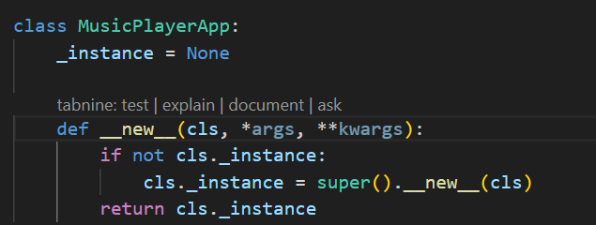
Design Pattern - Singleton
In the __new__ method, the Singleton Pattern is implemented by checking if an instance of the class already exists (cls._instance). If an instance exists, the existing instance is returned. If no instance exists, a new instance is created using the super().__new__(cls) method.
We can ensure that only one instance of the music player application is created, which helps maintain consistency and prevents multiple instances from being created.

Slide 22
Conclusion

Slide 23

Thanks!
Our Music Playlists
Search
Home
Library
Do you have any questions?
Nguyen Hong Son
ITDSIU21117
Please keep this slide for attribution

Slide 24
Resources
Slidesgo. (n.d.). Music Subject for High School: Sharing Our Music Playlists. Retrieved June 22, 2024, from https://slidesgo.com/theme/music-subject-for-high-school-sharing-our-music-playlists#search-music&position-14&results-415&rs=search
Canva. (n.d.). Canva. Retrieved June 22, 2024, from https://www.canva.com/
Ezgif. (n.d.). Ezgif - Speed. Retrieved June 22, 2024, from https://ezgif.com/speed
Psikka. (n.d.). GitHub - psikka/projects-yt: MusicPlayer. GitHub. Retrieved June 22, 2024, from https://github.com/achudnova/projects-yt/tree/main/MusicPlayer
Psikka. (n.d.). YouTube - Psikka: ChatGPT Implementation. Retrieved June 22, 2024, from https://www.youtube.com/watch?v=RqNgCgu5Vw8

